Slide 1
Short-text Similarity: A Survey
Kenny Zhu & Haixun Wang

Slide 2
Content
Introduction
Challenges
Word-to-word similarity
The Problem & Its Applications
What is short text?
Features of Similarity
Major applications
Main Approaches
Data Representation
Similarity Function
Performance Issues
Evaluation
Reference

Slide 3
Introduction

Slide 4
Challenges
Because of the short length, the text segments do not provide enough context for surface matching methods such as computing the cosine score of the two text segments to be effective.
On the other hand, because many text segments in these tasks contain more than one or two words, traditional corpus-based word similarity measures can fail too.
Linguistic thesauruses such as WordNet do not cover a signiﬁcant fraction of the input text segments.

Slide 5
No Semantic:
Between text
Keyword-based IR
Lexical matching method
String-based (edit distance, etc.)
Between words
“distributional similarity”
“relatedness”
Semantic:
Between two words
Between two concepts
Between two short texts (the derivation of a text-to-text measure of similarity starting from a word-based semantic similarity may not be straightforward)

Slide 6
Word-to-Word Semantic Similarity
Corpus-based Measures
Mutual Info (Dagon, et al. 1993, 1999)
Infer prob. Of co-occurrence which doesn’t exist.
pointwise mutual information (PMI) (Turney 2001)
2nd order co-occurrence PMI (Islam ‘08)
latent semantic analysis (LSA) (Landauer, Foltz, & Laham 1998)
HAL (Burgess et al. 1998)
Distributional similarity measures (Lillian Lee 1999): relatedness, not semantic similarity.
Estimate word co-occurrences for semantic similarity between words (Terra et al. 2003)
Ruiz-Casado et al. (2005) - replace w1 in google snippets with w2 and search for the snippets again.
Consider temporal patterns - TSA (Radinsky et al. 2010)

Slide 7
Word-to-Word Semantic Similarity
Knowledge-based Measures
Overview: Budanitsky & Hirst 2001, “Semantic distance in WordNet”
Agirre 2009: Wordnet + Personalized Pagerank
Combined approach
SVM of 4 methods combined. (Agirre 2009)
Resnik
Lin

Slide 8
Mutual Information

Slide 9
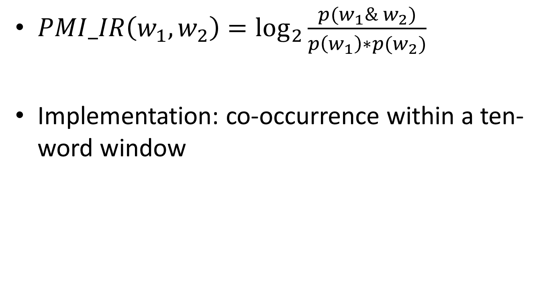
PMI (Turney 2001)
$PMI_IR\left(w_{1},w_{2}\right)=\log_{2}{\frac{p(w_{1}\& w_{2})}{p\left(w_{1}\right)∗p(w_{2})}}$
Implementation: co-occurrence within a ten-word window

Slide 10
Corpus-Based Word-word Similarity [Islam’08]
Second Order Co-occurrence PMI (SOC-PMI)
Measure the similarity of two words by the PMI of their neighboring words in large corpus
The neighboring words are like bridges
m is the number of tokens in corpus
X_{i} is the set of neighboring words

Slide 11
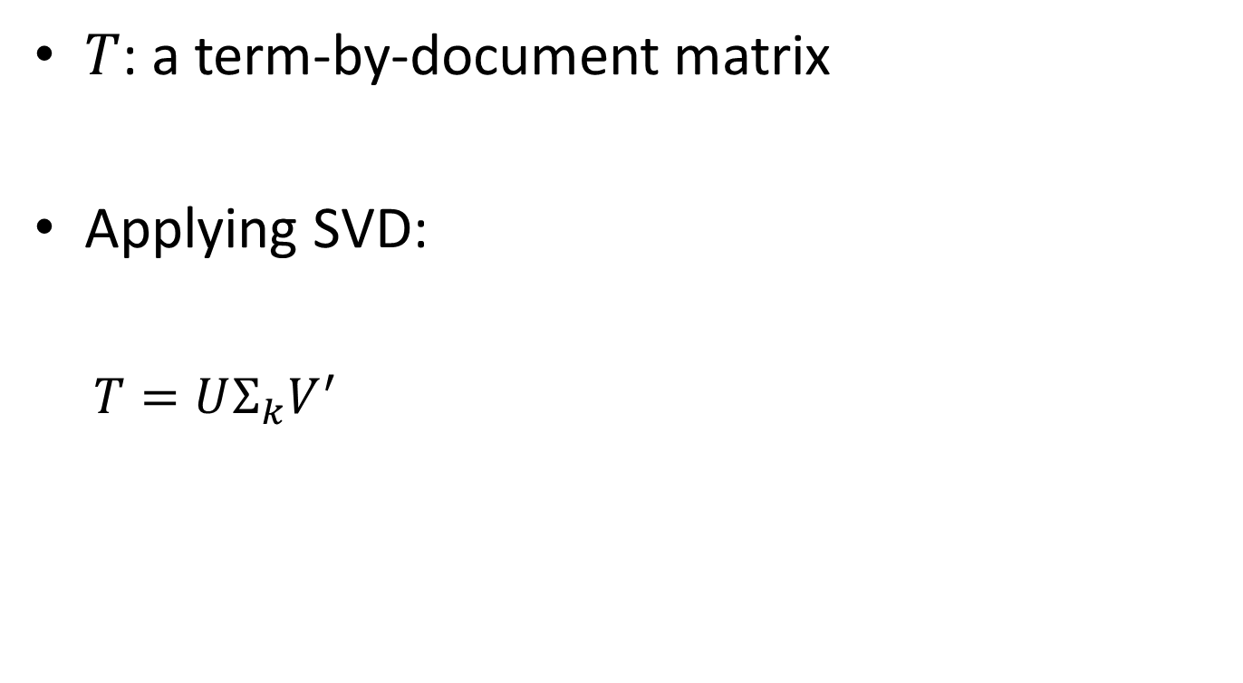
LSA (Landauer 1998)
$T$: a term-by-document matrix
Applying SVD:
$T=UΣ_{k}V^{′}$

Slide 12
TSA (Radinsky 2010)
Word-to-word relatedness (not semantic similarity)
Static Representation: concept vectors
Wikipedia concepts
Flickr tags
Del.icio.us bookmarks
Corpus from 130 years of NY Times articles
Extract temporal dynamics
Combine temporal dynamics with static representation

Slide 13
Knowledge-based Measures #1
Leacock & Chodorow 1998
Combining local context and WordNet sense similarity for word sense identification. In WordNet, An Electronic Lexical Database. The MIT Press.
shortest path between two concepts using node-counting
maximum depth of the taxonomy

Slide 14
Knowledge-based Measures #2
Lesk (1986):
Automatic sense disambiguation using machine readable dictionaries: How to tell a pine cone from an ice cream cone. In Proceedings of the SIGDOC Conference 1986.
The Lesk similarity of two concepts is defined as a function of the overlap between the corresponding definitions, as provided by a dictionary.

Slide 15
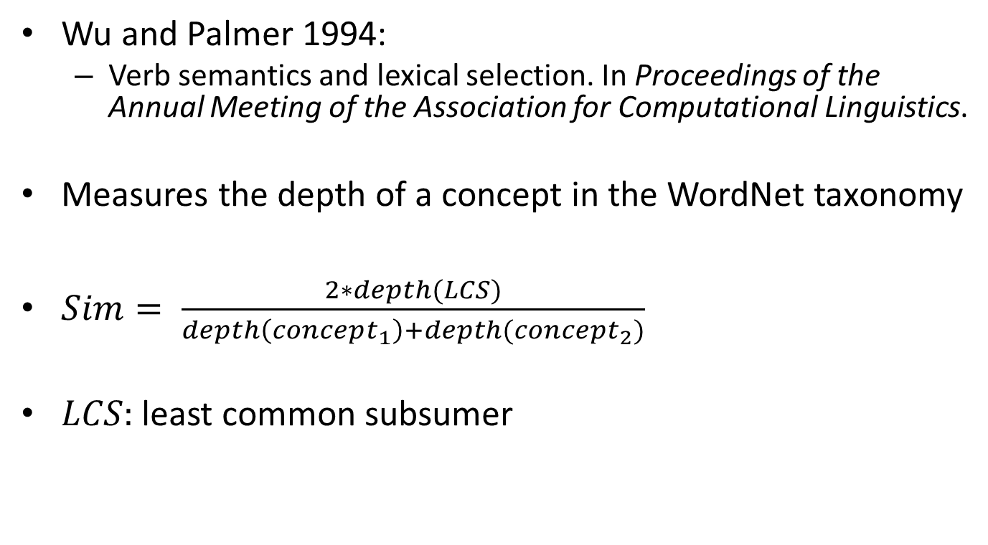
Knowledge-based Measures #3
Wu and Palmer 1994:
Verb semantics and lexical selection. In Proceedings of the Annual Meeting of the Association for Computational Linguistics.
Measures the depth of a concept in the WordNet taxonomy
$Sim= \frac{2∗depth(LCS)}{depth\left(concept_{1}\right)+depth(concept_{2})}$
$LCS:$least common subsumer

Slide 16
Knowledge-based Measures #4
P. Ganesan, H. Garcia-Molina, and J. Widom. Exploiting Hierarchical Domain Structure to Compute Similarity. ACM Trans. Inf. Syst., 21(1):64–93, 2003.

Slide 17
Knowledge-based Measures #5 (Tsatsaronis 2010)
Based on weighted path length between two senses in the taxonomy + depths in the taxonomy.
Weight is determined by edge type, e.g. hypernym-hyponym edge, normalization, category domain, etc.
Sim (t1, t2) =

Slide 18
Hybrid Approach #1
Resnik 1995
where and is the probability of encountering an instance of concept in a large corpus

Slide 19
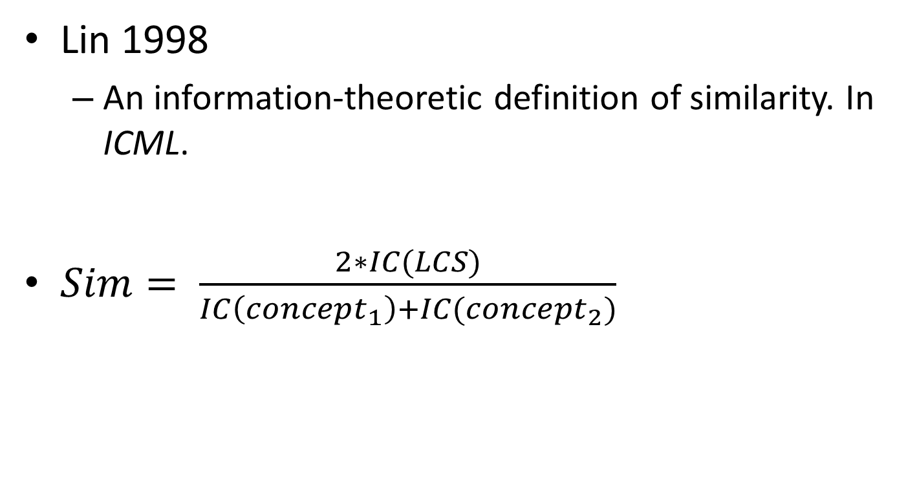
Hybrid Approach #2
Lin 1998
An information-theoretic definition of similarity. In ICML.
$Sim= \frac{2∗IC(LCS)}{IC\left(concept_{1}\right)+IC(concept_{2})}$

Slide 20
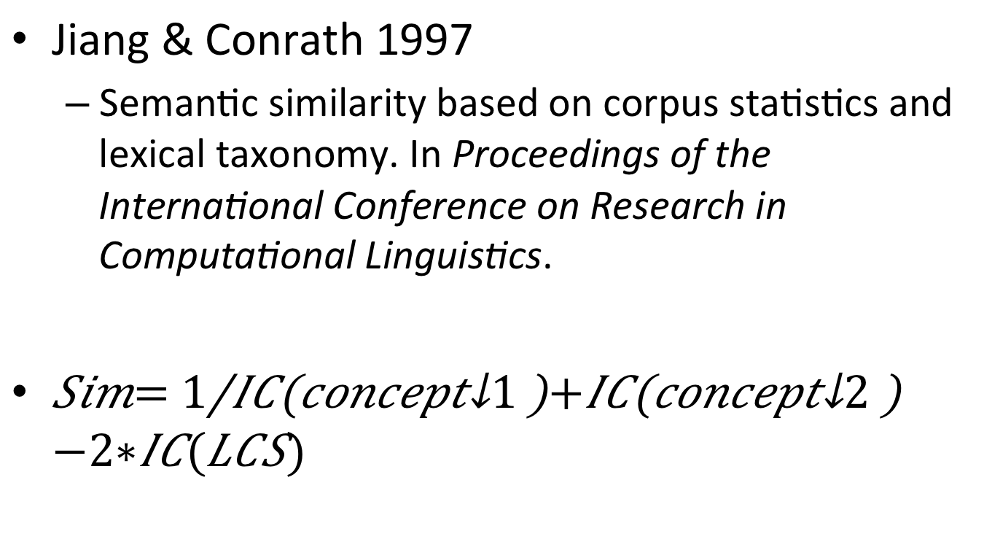
Hybrid Approach #3
Jiang & Conrath 1997
Semantic similarity based on corpus statistics and lexical taxonomy. In Proceedings of the International Conference on Research in Computational Linguistics.
$Sim= \frac{1}{IC\left(concept_{1}\right)+IC\left(concept_{2}\right)−2∗IC(LCS)}$

Slide 21
Annotate sense or not?
Ted Pederson (NAACL 2010) showed that it’s better to use corpora without sense tagged
Save manual labeling
This works for Resnik, Lin and Jiang’s methods above.

Slide 22
Hybrid Approach #4
(Agirre NAACL 2009)
Knowledge based similarity
WordNet graph + personalized pagerank
Distributional similarity:
Bag of Words (from a window)
Context Window (as the representation)
Dependency structure (syntax context)
Combined SVM
Trained on pairs of pairs of words
Whether the 1st pair of word is more similar than the 2nd pair
Outperforms most existing approaches

Slide 23
Problem & Main Applications

Slide 24
Short Text Similarity
Text contains limited number of words
May not be complete sentences
May contain abbreviations, errors and special symbols
Syntactic similarity:
Common substring
Common subsequence
Edit distance
Semantic similarity:
Synonyms
Concepts
Topics

Slide 25
Features of Similarity [O’Shea 08]
Semantic Similarity is a special case of Semantic Relatedness [Resnik ‘99]
(cars, gasoline) are more related
(cars, bikes) are more similar
Similarity involve just is-a links (and maybe part-of or property-of links)
Others use relatedness to measure similarity, in “Contextual Correlates of Meaning” [Charles 2000]

Slide 26
Features of Similarity (Cont’d)
Four forms of similarity [Klein and Murphy’02]:
Taxonomic: WordNet, noun similarity, synonyms
Thematic: co-occurrence, e.g. car and gasoline
Goal derived: similar if items achieve common goal
Radial: similar if linked by a chain of similar items, probably thru evolutionary process

Slide 27
Features of Similarity (Cont’d)
Similarity is asymmetric sometimes
Typically similarity is measured on a scale from 0 to 4
Can’t represent oppositeness, which may have high co-occurrence similarity
Items with complex features are more likely to be assimilated by humans

Slide 28
Main Applications
Query rewriting/expansion [Metzler ’07]
Query-ads match [Metzler ’07]
Image search [Metzler ’07]
Conversational agents [O’Shea ‘08]
A number of rules containing a few prototype sentences
Compare the similarity between a user utterance with the prototype sentences, and generate firing strength for each rule
Search and clustering of short comments (reviews, tweets, titles)

Slide 29
Main Approaches
Surface Matching
Meadow et al. 2000, Salton & Lesk 1971, Corley & Mihalcea 2005, Metzler, et. Al . 2007
Feature Based
Hatzivassiloglou ‘99
Corpus Based
Methods:
PMI (Turney 2001)
Latent semantic analysis (Landauer, Foltz, Laham 1998)
Normalized document set overlap (Fitzpatrick, Dent 1997)
Mihalcea & Corley 2006
Burgess et al. 1998, Lee 2005, O’Shea 2008, Islam 2008, Sahami & Heilman 2006, Yih & Meek 2007,
User-behavior Based
Jones 2006, Xu 2011, Guo 2011
Knowledge Based and Hybrids
Lin 1998, Resnik 1999, Zelikovitz 2000
Tsatsaronis 2010

Slide 30
Data Representation

Slide 31
Representation
Bag of words (stemmed, synonyms, etc.)
Bag of N-grams
Bag of Concepts
String/substrings/Subsequences
Vector of frequencies
Word order vector (Li et al. 2006)
Linguistic features (Hatzivassiloglou ‘99)
Binary
Counting
Tag similarity – resources vectors in folksonomy (Markines 2009)
Intent (Guo 2011)
Search intent provides constraints on query similarity

Slide 32
Bag (vector) of Words/N-grams
(McGill 1979, Xu & Xu 2011)
Surface form
Original text without any changes
In the simplest form: a multiset/set of words in the input text.
Words can be stemmed first to their canonical forms
Introduces noises
But overall still beneficial
Use Porter stemmer
Synonyms can be represented by their corresponding synset id in Wordnet
Other than words, N-grams (N consecutive chars) are also used.
Advantage is that the space is bounded for small N
Usually very sparse
Can be binary or weighted (McGill 1979)

Slide 33
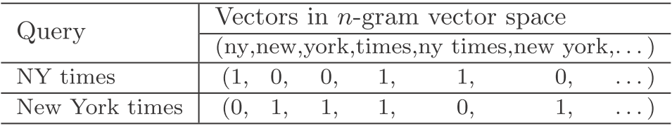
N-gram representation
But, (New York times, NY times) and (New York times, movie times) will have the same score if we use cosine similarity directly.

Slide 34
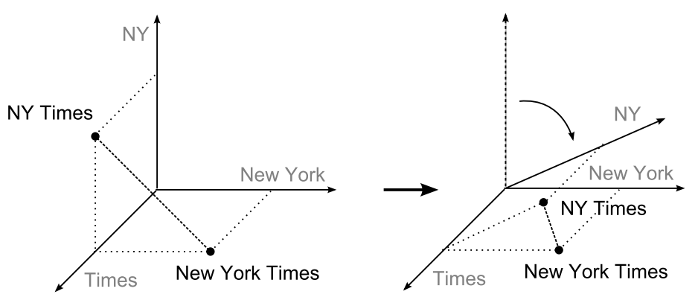
Transformation between n-gram spaces
We try to ﬁnd a transformation that can make the angle between “NY” and “New York” approach to zero.

Slide 35
Bag of Concepts
Each term in text matches concept in a taxonomy [Resnik’99]
The term is represented by a subtree rooted at the corresponding concept in the taxonomy
Weight vector of Wikipedia concepts [Gabrilovich et al. 2007]

Slide 36
Substring/Subsequence
String similarity can be part of the overall similarity between texts
Similarity = string sim + semantic word sim + common word order sim (Islam & Inkpen 2008)
Instead of exact matching of two words, we can compare the substrings/subsequences of two words
Longest Common Subsequence (LCS) algorithm (Allison and Dix 1986)
Three different LCS methods and take the weighted sum of all three (Islam & Inkpen 2008)

Slide 37
Linguistic Features [Hatzivassiloglou ‘99]
Compute feature vector over a pair of texts
Features are either:
Primitive Features
Composite Features

Slide 38
Tags in Folksonomy (Markines 2009)
(t, r, u) tripple to represent social tagging system
Aggregate over users
Represent t by r vectors
Represent r by t vectors
Projective
Distributional
Macro-aggregation

Slide 39
Primitive Features
Word co-occurrence
Matching noun phrase
Wordnet Synonyms
Common verb classes
Common proper nouns
Normalization:
Feature_value/sqrt(len(A) * len(B))
Feature_value/log(# of texts/# texts containing the feature) → similar to IDF in TF*IDF

Slide 40
Composite Features
Ordering
Two pairs of primitive features preserves ordering
Distance
Two pairs of primitive features occur within distance in text
Primitive
Only certain specific primitive feature is used

Slide 41
Data Augmentation
Information in short text is often insufficient
Use the words in the documents that contain or is related to the short text as the expanded representation of the short text.
Web search result documents
Web search snippet
Search/clickthrough/session logs
Collaborative filtering (Markines 2009)
Knowledge bases

Slide 42
Web Search Results
(Sahami & Heilman 2006)
Enter short text as web queries
Use the web search result (documents and pages) as the extended context of the short text
Formulate context vectors to represent the short text

Slide 43
Web Search Snippets
(Metzler et al. 2007)
This is a more succinct form than web search results in previous slide
Only the search result “snippets” are used as expanded representation of the original short text.

Slide 44
Collaborative Filtering
Used to model similarity between tags in social tagging systems (WWW 2009):

Slide 45
Logs
(Guo 2011)
Largely used in query suggestion or query rewriting/expansion
Take into account the click through and session graphs when computing the similarity of two queries
Two queries result in same clicks → queries have similar “intent”

Slide 46
Knowledge Bases
Word Net [Hatzivassiloglou ‘99]
Semantic Class [Hatzivassiloglou ‘99]
Taxonomy [Resnick ‘99]
Wikipedia concept [Gabrilovich et al, 2007]

Slide 47
Similarity Function
Pair-wise
Graph-based
Learning a similarity function

Slide 48
Pair-wise Similarity
Surface Matching
String Similarity
Common/Extended Word-order Similarity
Binary vs. Counting similarity
Semantic Similarity
Word Specificity
Corpus based word-to-word similarity
Linguistic Features
Web-based similarity kernel (expanded rep)
Other corpus-based similarity measures
Taxonomy based similarity
Combined similarity
Intent-based similarity

Slide 49
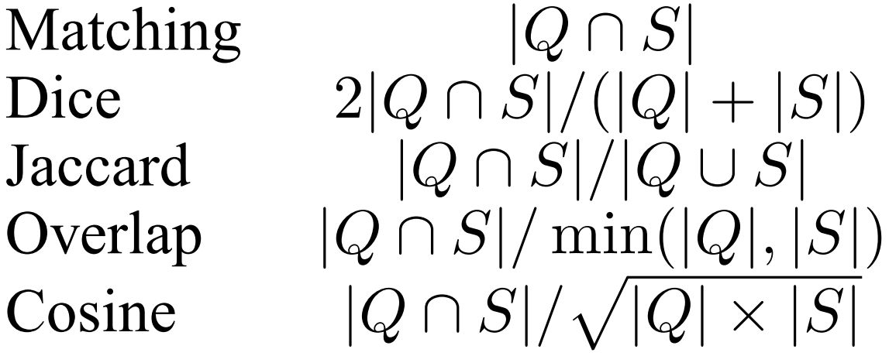
Surface Matching
Traditional text matching approach
For two short texts q and s, and let Q and S be the set of words in q and s, we can measure similarity of q and s by:
Manning & Schutze 1999: Foundations of Statistical Natural Language Processing. The MIT Press.

Slide 50
Surface Matching
Variations:
Using the stemmed words instead of the original words
Two words can be matched if they are synonyms according to WordNet
Frequency can be introduced to form a vector of (word, freq) pairs instead of set of words
67 diff sim measures (McGill 1979)
Meadow et al. 2000, Salton 7 Lesk 1971, Corley & Mihalcea2005
Quality is unreliable: Sahami & Heilman 2006, A web-based kernel function for measuring the similarity of short text snippets.

Slide 51
Deficiencies of Surface Matching
Term based: if terms are missing or mismatched, then zero similarity
E.g. UAE vs. United Arab Emirates
Context are missing in short text
E.g. Apple pie vs. Apple computers

Slide 52
String Similarity [Islam ‘08]
Longest Common Subsequence (LCS)
Take the weighted sum of three modified/normalized LCS
v₁ = len(LCS(s1, s2))²/(len(s1) x len(s2))
v₂ = len(MCLCS₁(s1, s2))²/(len(s1) x len(s2))
v₃ = len(MCLCS_{n}(s1, s2))²/(len(s1) x len(s2))
MCLCS₁ starts matching from 1st char
MCLCS_{n} starts matching from any char

Slide 53
Common Word Order Similarity
For two texts P and R: put the d common words into two lists, X and Y, preserving their order in the texts.
Common word order sim is:
x_{i} and y_{i} are index number (position) in the X

Slide 54
Extended Word Order Similarity (Li et al. 2006)
Word order vectors:
r1 = {1, 2, 0, 0, 3, 4, 5, 6, 0}
r2 = {2, 0, 1, 0, 4, 5, 3, 0, 6}
Similarity:

Slide 55
Binary vs. Counting Similarity
Binary Models
x_{ik} = # of times i^{th} word (n-gram) occurs in k^{th} document
t_{ik} = 1 if x_{ik} > 0 and t_{ik} = 0 if x_{ik} = 0
Four different counts based on t_{ik}:
a_{ij}: number of words occurred in both doc i and j
b_{ij} and c_{ij}: number of words occurred in one but not the other doc
d_{ij}: number of words occurred in neither doc

Slide 56
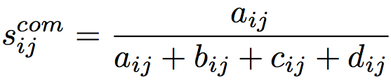
Binary Similarity Models
Based on the previously defined a, b, c and d:
Common:
Ratio:
Distinct:
Ratio and Common better than distinct, and approaches best correlation (similarity) of 0.5 at 7-gram/8-gram
Common appears to have better precision at high similarity, but low recall

Slide 57
Counting Similarity Models
Four symmetric models [Rorvig ‘99]:
Correlation (Dice)
Jaccard
Cosine
Overlap
Performs about the same: approaches max similar at 4-gram and above
But in general not as good as the binary models!

Slide 58
Specificity of Words
Give a higher weight to a semantic matching identified between two specific words (e.g. collie and sheepdog)
Give less importance to the similarity measured between generic concepts (e.g. get and become)
Specificity: can be measured by a word’s depth in the semantic hierarchy
[Mihalcea et al. 2006]

Slide 59
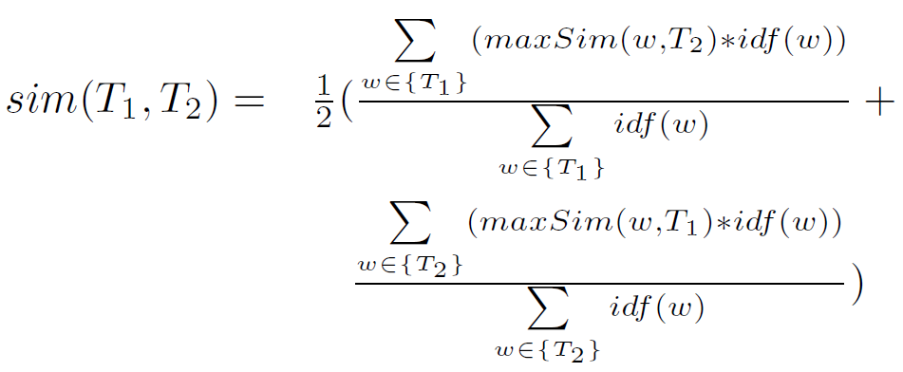
Semantic Similarity of Two Texts

Slide 60
Linguistic Features [Hatzivassiloglou ‘99]
Composite similarity metric between short textual units based on multiple linguistic features
A more restricted definition of text similarity than conventional document similarity
Results show effectiveness in identifying closeness between short texts

Slide 61
Similarity By Linguistic Features
A form of semantic similarity
Two short texts are similar if:
They share common concepts/actor/object/action
Common actor/object must perform/be subjected to the same action
Note “action” is quite important here
This is a more restrictive way of defining similarity

Slide 62
Methodology
Compute feature vector over a pair of texts
Features are either:
Primitive Features
Composite Features

Slide 63
Primitive Features
Word co-occurrence
Matching noun phrase
Wordnet Synonyms
Common verb classes
Common proper nouns
Normalization:
Feature_value/sqrt(len(A) * len(B))
Feature_value/log(# of texts/# texts containing the feature) → similar to IDF in TF*IDF

Slide 64
Composite Features
Ordering
Two pairs of primitive features preserves ordering
Distance
Two pairs of primitive features occur within distance in text
Primitive
Only certain specific primitive feature is used

Slide 65
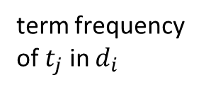
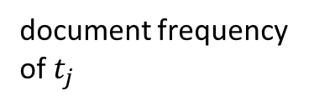
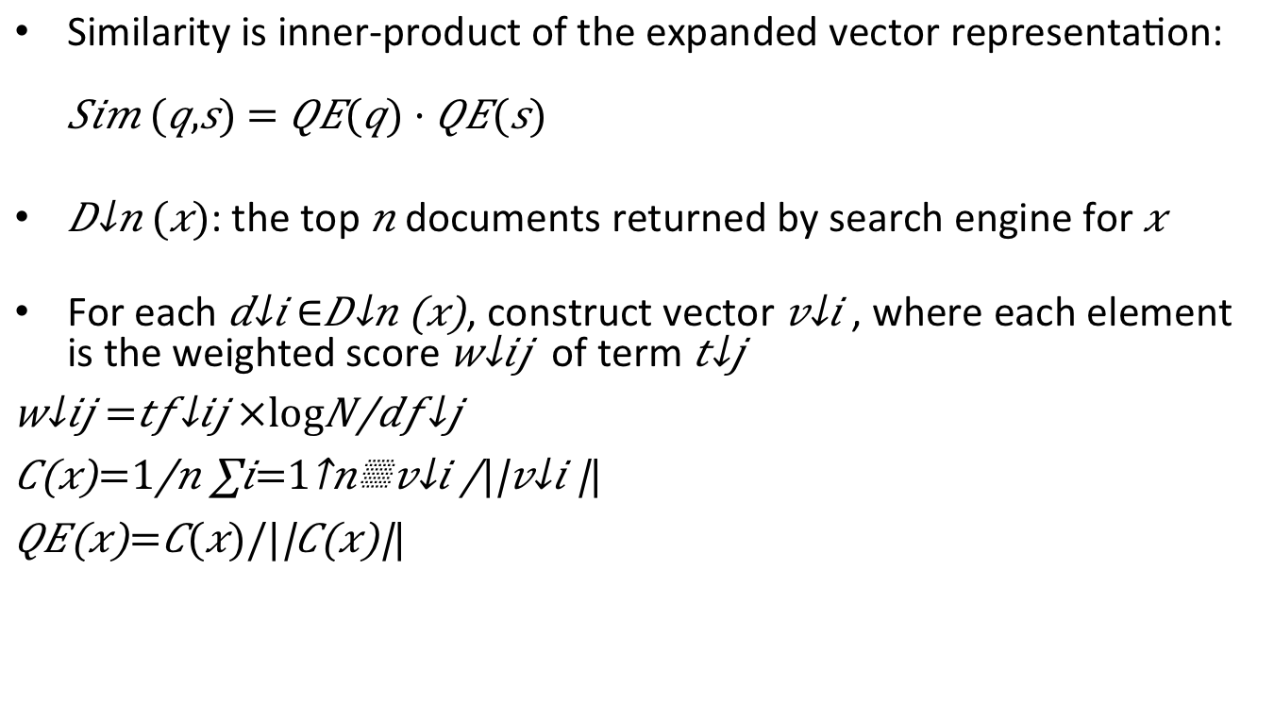
Web-based Similarity Kernel (Sahami & Heilman 2006)
Similarity is inner-product of the expanded vector representation: $Sim (q,s) = QE(q) · QE(s)$
$D_{n}(x)$: the top $n$ documents returned by search engine for $x$
For each $d_{i}∈D_{n}\left(x\right)$, construct vector $v_{i}$, where each element is the weighted score $w_{ij}$ of term $t_{j}$
$$w_{ij}=tf_{ij}×\log{\frac{N}{df_{j}}}$$
$$C\left(x\right)=\frac{1}{n}\sum_{i=1}^{n}{\frac{v_{i}}{|\left|v_{i}\right||}}$$
$$QE\left(x\right)=C(x)/|\left|C\left(x\right)\right||$$
document frequency of $t_{j}$
term frequency of $t_{j}$ in $d_{i}$

Slide 66
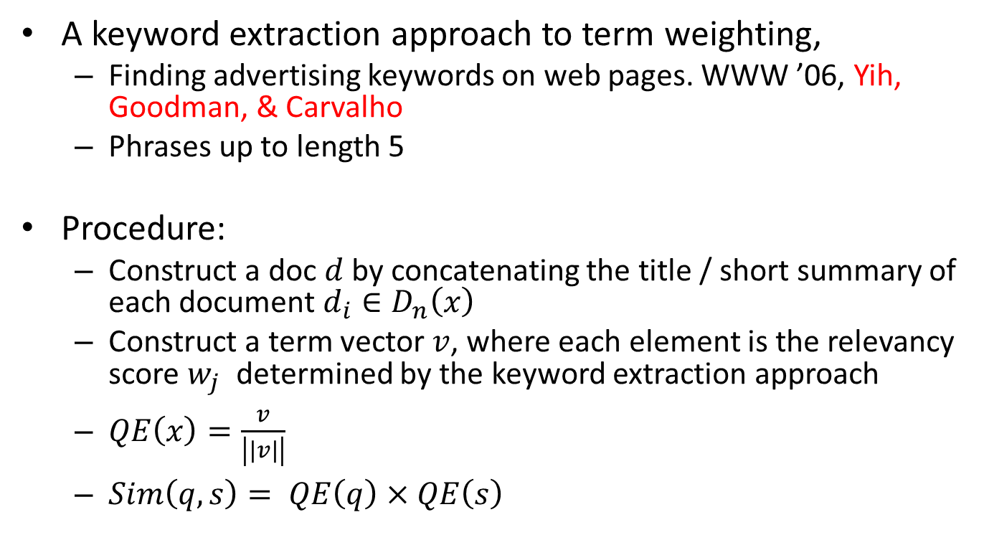
Web-relevance Similarity Measure (Yih & Meek 2007)
A keyword extraction approach to term weighting,
Finding advertising keywords on web pages. WWW ’06, Yih, Goodman, & Carvalho
Phrases up to length 5
Procedure:
Construct a doc $d$ by concatenating the title / short summary of each document $d_{i}∈D_{n}\left(x\right)$
Construct a term vector $v$, where each element is the relevancy score $w_{j}$ determined by the keyword extraction approach
$QE\left(x\right)=\frac{v}{\left|\left|v\right|\right|}$
$Sim\left(q,s\right)= QE\left(q\right)×QE\left(s\right)$

Slide 67
LSA Similarity Model
Local weighting functions and global weighting functions
Weighted corpus representation W = [w_{ik}]
W is subjected to singular value decomposition:
choose a dimensionality d <= m for the subspace representation
find the n x d orthonormal matrix U, the d x d diagonal matrix D and the m x d orthonormal matrix V that minimize the squared difference $|\left|W−UDV^{T}\right||$
Varying the global weighting function is more significant
Overall LSA achieves 0.6 correlation, close to humans.

Slide 68
STASIS [O’Shea ’08]
A hybrid method
s(w1, w2) based on path length and depth of the two words in a lexical database (something like WordNet)
S(T1, T2) combines word position info and word frequency info from a large corpus
Correlation with mean human ratings:
STASIS: 0.816
LSA: 0.838
Average Human: 0.825
Worse Human: 0.594
Best Human: 0.921

Slide 69
Semantic similarity in a taxonomy
A time-honored way: edge counting
Measure the distance between the nodes corresponding to the items being compared.
The shorter, the more similar.
If there are >1 paths, take the shortest one
Problem: Varying link distance
Links in the taxonomy represent uniform distance?
Narrow distance: (Rabbit Ears is-A Television Antenna), (Safety Valve is-A Valve)
Wide distance: (Phytoplankton is-A Living Thing), (Knitting Machine is-A Machine)

Slide 70
Weighted Path Length + Depths (Tsatsaronis 2010)
Lexical relatedness between a in sentence A and b in sentence B:

Slide 71
Philip Resnik, 1999
Measure similarity by information content
Combining a taxonomic structure with empirical probability estimates
Goal: disambiguation in NL:
(food handling and storage) procedures (food handling) and (storage procedures)

Slide 72
One key to the similarity of two concepts is the extent to which they share information
Edge counting measures “shared information” indirectly.

Slide 73
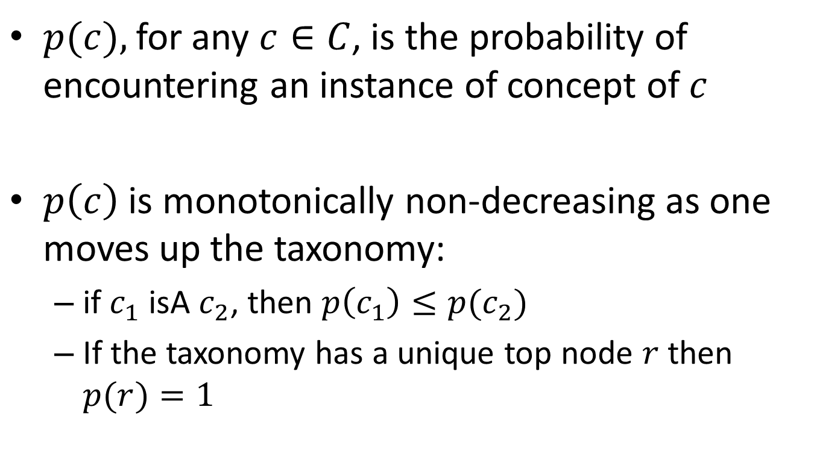
$p(c),$for any $c∈C$, is the probability of encountering an instance of concept of $c$
$p\left(c\right)$ is monotonically non-decreasing as one moves up the taxonomy:
if $c_{1}$ isA $c_{2}$, then $p\left(c_{1}\right)≤p(c_{2})$
If the taxonomy has a unique top node $r$ then $p(r)=1$

Slide 74
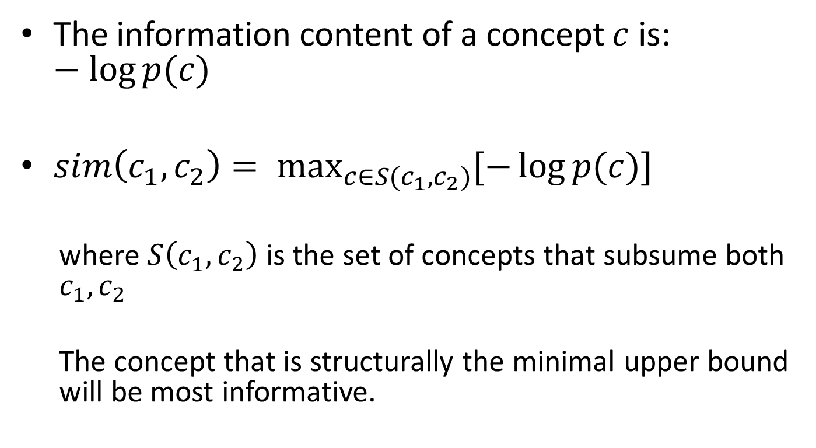
The information content of a concept is:
where is the set of concepts that subsume both
The concept that is structurally the minimal upper bound will be most informative.

Slide 75
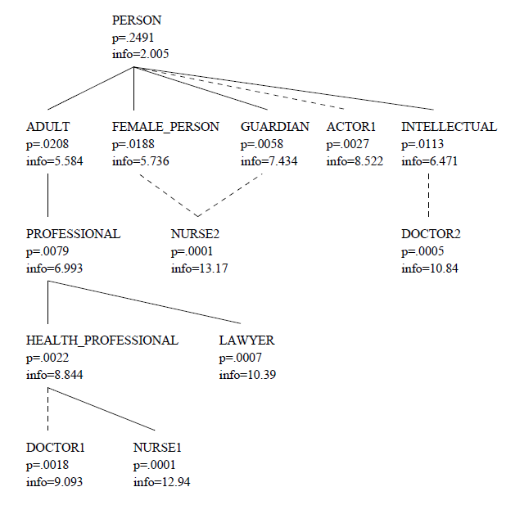
Information content of a fragment of the WordNet taxonomy

Slide 76
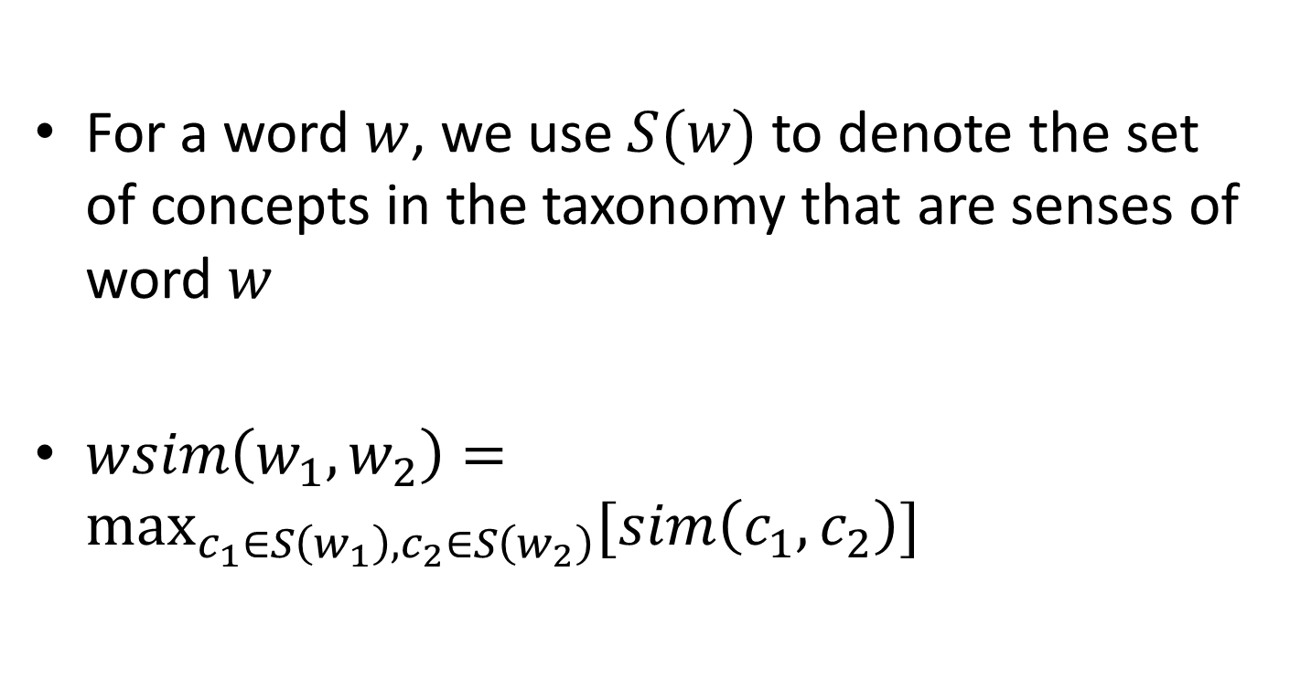
For a word $w$, we use $S(w)$to denote the set of concepts in the taxonomy that are senses of word $w$
$wsim\left(w_{1},w_{2}\right)=\max_{c_{1}∈S\left(w_{1}\right),c_{2}∈S\left(w_{2}\right)}{[sim\left(c_{1},c_{2}\right)]}$

Slide 77
Combined Similarity (Li et al. 2006)

Slide 78
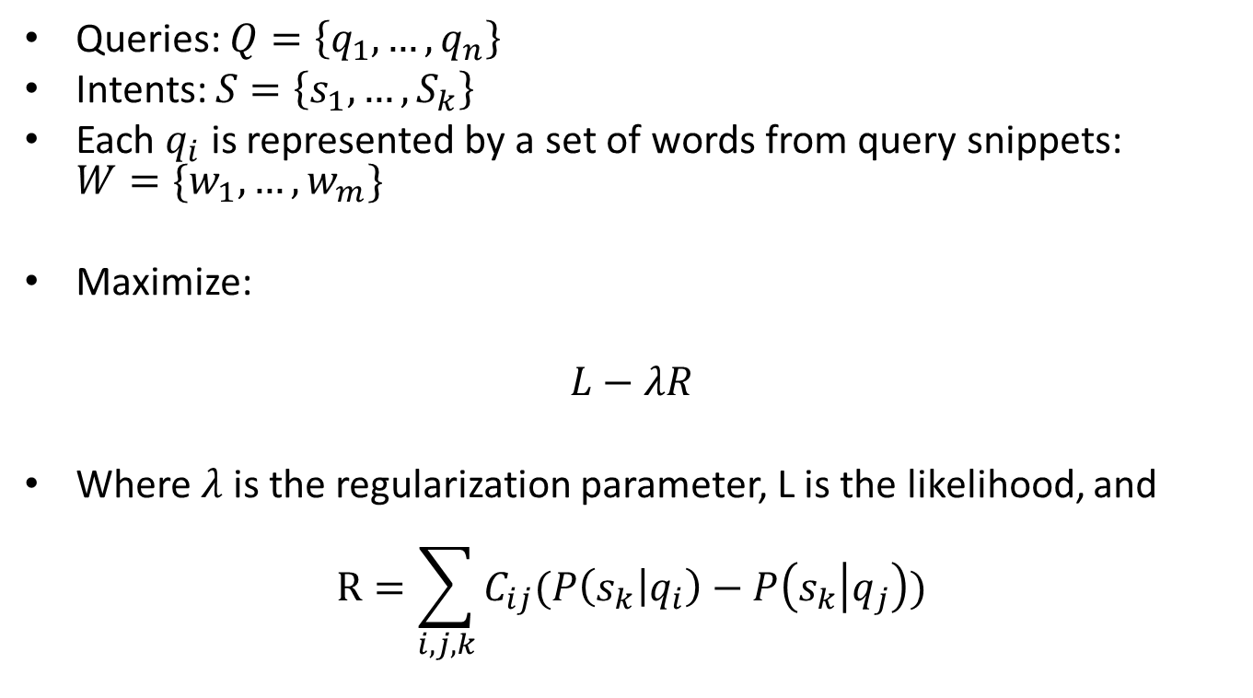
Intent-based Similarity (regularized topic model)
Queries: $Q=\left\{q_{1},…,q_{n}\right\}$
Intents: $S=\left\{s_{1},…,S_{k}\right\}$
Each $q_{i}$ is represented by a set of words from query snippets: $W=\{w_{1},…,w_{m}\}$
Maximize:
$$L−λR$$
Where $λ$ is the regularization parameter, L is the likelihood, and
$$R=\sum_{i,j,k}{C_{ij}(P\left(s_{k} | q_{i}\right)−P\left(s_{k} | q_{j}\right))}$$

Slide 79
Graph based approach for query similarity
SIGIR 07, Random walks on the click graph
SIGIR 10, Query similarity by projecting the query-ﬂow graph
CIKM 08, Query suggestion using hitting time
VLDB 08, Simrank++: query rewriting through link analysis of the click graph
CIKM 08, Learning latent semantic relations from clickthrough data for query suggestion.
CIKM 08, The query-ﬂow graph: model and applications.
WSCD 09, Query suggestions using query-ﬂow graphs.

Slide 80
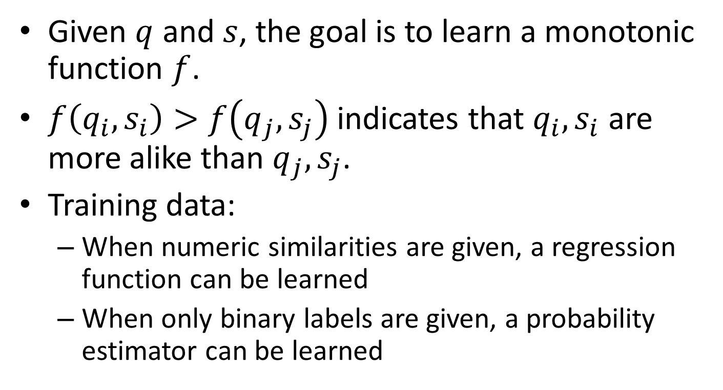
Learning Similarity Measures: Method #1 [Yih & Meek ‘07]
Given $q$ and $s$, the goal is to learn a monotonic function $f$.
$f\left(q_{i},s_{i}\right)>f\left(q_{j},s_{j}\right)$ indicates that $q_{i},s_{i}$ are more alike than $q_{j},s_{j}$.
Training data:
When numeric similarities are given, a regression function can be learned
When only binary labels are given, a probability estimator can be learned

Slide 81
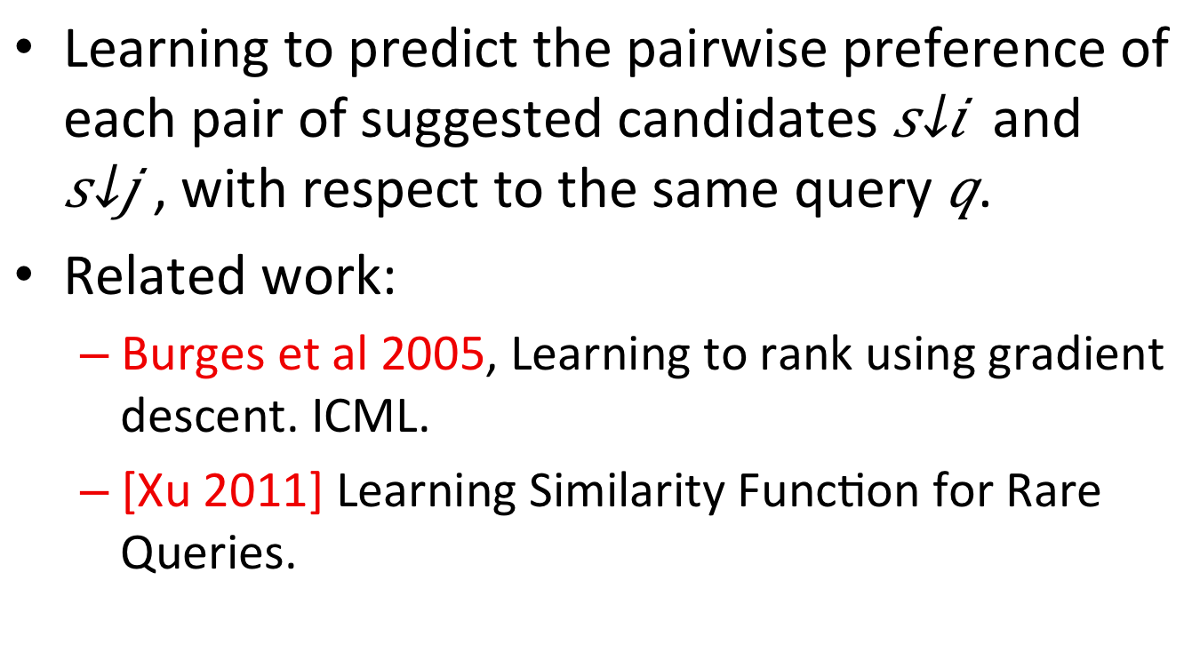
Learning Similarity Measures: Method #2 [Yih & Meek ‘07]
Learning to predict the pairwise preference of each pair of suggested candidates and , with respect to the same query .
Related work:
Burges et al 2005, Learning to rank using gradient descent. ICML.
[Xu 2011] Learning Similarity Function for Rare Queries.

Slide 82
Performance Issues
In [Sahami et al. 2006], web based similarity kernel can be improved in two ways:
Consider only highly weighted terms in vectors
Use only summary (i.e. snippets) instead of whole docs
According to [Metzler et al. 2007]
Lexical and stemming matching are fast
Probabilistic methods are slower:
SparseProb: 0.15 sec/query
DenseProb: 3 sec/query
Xu & Xu 2011 uses Locality Sensitive Hashing (LSH) to speed up similarity search.
Approx. 0.5 sec per query vs 43 sec per query by linear scan
But sacrifices some recall

Slide 83
Evaluation
Metric/Tools
Human Judgements
Data sets

Slide 84
Metric
Area Under the Curve (AUC) score [Yih 2007]:
Precision at k
Top ranked k elements
Coverage (Recall)
Surface matching
Corpus-based
Learning-based

Slide 85
WHIRL (a DB system with string similarity)
[Zelikovitz et al. 2000]
Compared WHIRL-nn (baseline) with RIPPER
Do better in tech papers and news but not so good in web page titles and company names
Compare WHIRL-bg with WHIRL-nn
WHIRL-bg is less sensitive to training data size, in other words, it requires little training data to achieve rather good performance

Slide 86
Human Judgments
[Lee et al., 2005] compares various computation models with human minds in short text similarity (correlation)
Pearson’s correlation
Spearman’s correlation
Human judgement
Judge rate with 4-point scale: excellent, good, fair and bad
Convert to binary decision: relevant or irrelevant
Standard inter-annotator correlation:
Kappa statistic (Ng, Lim, & Foo 1999; Carletta 1996; Siegel & Castellan 1988).

Slide 87
Test Data
Microsoft para- phrase corpus (Dolan, Quirk, & Brockett 2004), consisting of 4,076 training and 1,725 test pairs
Word Similarity: Rubenstein-Goodenough’s 65 pairs
Word relatedness: WordSimilarity-353 collection [Finkelstein et al. 2002]
Human scores for the above two word-to-word data: Budanitsky and Hirst (2006)
TOEFL Synonym 80 questions
ESL Synonym 50 questions
SAT Analogy 374 word pairs
Sentence similarity: Derived from RG-65 into 65 sentence pairs by getting dictionary definition of each word (Li, et al. 2009, TKDE)
Doc similarity: 50 docs from Australian Broadcasting Corp. [Lee et al. 2005]
Others:
Tech papers
News
Web page titles
Company names
Google N-grams
Short answers in test/quiz: [Mohler 2009]

Slide 88
Major References
1999 Detecting text similarity over short passages
1999 Semantic Similarity in a Taxonomy
2000 Improving Short-Text Classification Using Unlabeled Background Knowledge
2005 An empirical evaluation of models of text document similarity
2006 A web-based kernel function for measuring the similarity of short text snippets
2006 Corpus-based and knowledge-based measures for text semantic similarity
2007 Improving similarity measures for short segments of text
2007 Similarity measures for short segments of text
2008 A comparative study of two short text semantic similarity measures
2008 Semantic Text Similarity Using Corpus-Based Word Similarity and String Similarity
2011 Learning Similarity Function for Rare Queries
2011 Intent-aware query similarity

Slide 89
E. Gabrilovich and S. Markovitch. Computing semantic relatedness using wikipedia-based explicit semantic analysis. In AAAI, pages 6–12, 2007.
B. Sriram, D. Fuhry, E. Demir, H. Ferhatosmanoglu, and M. Demirbas. Short text classiﬁcation in twitter to improve information ﬁltering. In SIGIR, pages 841–842, 2010.
Xinruo Sun, Haofen Wang, Yong Yu. Towards effective short text deep classification. In SIGIR '11, 2011.
Vitale, D. and Ferragina, P. and Scaiella, U. Classification of Short Texts by Deploying Topical Annotations. In Advances in Information Retrieval, 2012.
1993 Context Word Similarity
2003 Frequency Estimates
1999 Similarity Based Model
1999 Measures Distributional Similarity
2010 Pedersen Information Content
2011 Radinsky A Word At A Time

Slide 90
2009 A study similarity relatedness
2010 Text Relatedness Word Thesaurus
2009 Mohler Text to Text
2001 Semantic Distance WordNet
2009 Semantic Similarity Metric
2006 Evaluating WordNet Measures
2007 Measuring Semantic Similarity between Words
2009 Evaluating Similarity Measures for Emergent Semantics of Social Tagging
2012 Improving Word Representation
2010 A Feature and Information Theoretic Framework
1998 An Information-Theoretic Definition of Similarity
1979 An evaluation of factors affecting document ranking by information retrieval systems

Slide 91
User Behavior (Other Works)
Q. Mei, D. Zhou, and K. Church. Query suggestion using hitting time. CIKM ’08
H. Ma, H. Yang, I. King, and M. R. Lyu. Learning latent semantic relations from clickthrough data for query suggestion. CIKM ’08
D. Beeferman and A. Berger. Agglomerative clustering of a search engine query log. KDD ’00
J.-R. Wen, J.-Y. Nie, and H.-J. Zhang. Clustering user queries of a search engine. WWW ’01
Z. Zhang and O. Nasraoui. Mining search engine query logs for query recommendation. WWW ’06

Slide 92
END

Slide 93
Common Aspects
Data Augmentation
External data source (Web, log, knowledge bases)
Represent short text
Bag of words, n-gram, intent, …
Similarity function
Pair-wise
Graph based
Learning a similarity function

Slide 94
Data Augmentation
Information in short text is often insufficient
Use the words in the documents that contain or is related to the short text as the expanded representation of the short text.
Web snippet
Search log
Knowledge bases
Compute Similarity score between the new representations.
Using:
KL divergence, Metzler, et. Al . 2007
Web-based:
Sahami & Heilman 2006
Yih & Meek 2007

Slide 95
Main Approaches
Surface Matching
Feature-based
Corpus-based
User behavior (click-through, session data)
Knowledge based

Slide 96
Surface Matching
Traditional text matching approach
For two short texts q and s, and let Q and S be the set of words in q and s, we can measure similarity of q and s by:
Manning & Schutze 1999: Foundations of Statistical Natural Language Processing. The MIT Press.

Slide 97
Surface Matching
Variations:
Using the stemmed words instead of the original words
Two words can be matched if they are synonyms according to WordNet
Frequency can be introduced to form a vector of (word, freq) pairs instead of set of words
Meadow et al. 2000, Salton 7 Lesk 1971, Corley & Mihalcea2005
Quality is unreliable: Sahami & Heilman 2006, A web-based kernel function for measuring the similarity of short text snippets.

Slide 98
Similarity Measures for Short Segments of Text ECIR 2007

Slide 99
Highlights
This paper examines a number of similarity measures for short texts
Pure lexical
Stemming
Language modeling based
Evaluate these measures on query-to-query similarities from search log (360k queries)

Slide 100
Text Representation
Surface form
Original text without any changes
Stemmed form
Introduces noises
But overall still beneficial
Use Porter stemmer
Expanded form
Web query results
Top 200 titles and snippets for each short text query

Slide 101
Deficiencies of Standard Similarity Measures
Term based: if terms are missing or mismatched, then zero similarity
E.g. UAE vs. United Arab Emirates
Context are missing in short text
E.g. Apple pie vs. Apple computers

Slide 102
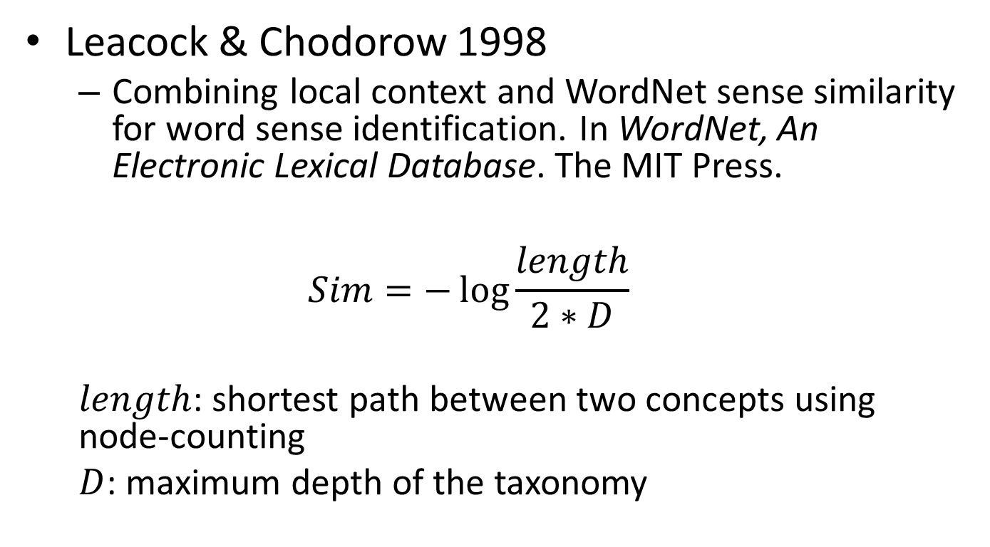
Similarity Measures
Lexical
Exact
Phrase (substring)
Subset (of terms)
Probabilistic
Negative symmetric entropy (KL divergence)
Sim(q, c) = - KL(q, c)=$\sum_{w∈V}{P\left(w | q\right)log⁡(P\left(w | c\right))}$
Where q is the query and c is the candidate
SparseProb: surface query
DenseProb: expanded query
Always expand the candidate
Hybrid
Concatenate the matched candidate lists from different methods above and form a new list
Remove duplicates during the concat
Defined by some ordering, e.g. exact > phrase > subset
Backoff: Exact > Exact Stems > DenseProb

Slide 103
Evaluation
Judge rate with 4-point scale: excellent, good, fair and bad
Treat excellent/good as relevant, the performance:
Backoff > Prob methods > lexical methods
Backoff is good because it includes exact matches missed by prob methods
Efficiency
Lexical methods are fast
Prob methods are slower, denseProb is slower (3 sec) than sparseProb (0.15 sec)
SparseProb is the best overall performer

Slide 104
Feature Based

Slide 105
Similarity by Linguistic Features [Hatzivassiloglou ‘99]
Composite similarity metric between short textual units based on multiple linguistic features
A more restricted definition of text similarity than conventional document similarity
Results show effectiveness in identifying closeness between short texts

Slide 106
Similarity By Linguistic Features
A form of semantic similarity
Two short texts are similar if:
They share common concepts/actor/object/action
Common actor/object must perform/be subjected to the same action
Note “action” is quite important here
This is a more restrictive way of defining similarity

Slide 107
Methodology
Compute feature vector over a pair of texts
Features are either:
Primitive Features
Composite Features

Slide 108
Primitive Features
Word co-occurrence
Matching noun phrase
Wordnet Synonyms
Common verb classes
Common proper nouns
Normalization:
Feature_value/sqrt(len(A) * len(B))
Feature_value/log(# of texts/# texts containing the feature) → similar to IDF in TF*IDF

Slide 109
Composite Features
Ordering
Two pairs of primitive features preserves ordering
Distance
Two pairs of primitive features occur within distance in text
Primitive
Only certain specific primitive feature is used

Slide 110
Evaluation
Learn classifier using RIPPER
Tune the loss ratio
Achieves 36.6% recall + 60.5% precision
Effective individual features:
Any word
Simplex NP
Noun
Effective composite feature
Verb distance <= 5 (however recall is low)

Slide 111
Corpus Based

Slide 112
Corpus-based Methods
Do q and s co-occur in the same document?
Methods:
PMI (Turney 2001)
Latent semantic analysis (Landauer, Foltz, Laham 1998)
Normalized document set overlap (Fitzpatrick, Dent 1997)
When length of q and s gets longer, they tent to not co-occur

Slide 113
HAL
Hyperspace Analogues to Language (Burgess et al. 1998)
Lexical co-occurrence to construct a semantic space
Words are points in this space
Distance between two sentences are the distance between two rep vectors

Slide 114
Corpus-based and knowledge-based measures for text semantic similarity, AAAI 2006
Goal: Automatically derive a score that indicates the semantic similarity of two short pieces of texts.
Model the semantic similarity of texts as a function of
Word to word similarity (corpus or knowledge based)
Word specificity (IDF, in fact also corpus based)
Structure of the text is not considered

Slide 115
Specificity of Words
Give a higher weight to a semantic matching identified between two specific words (e.g. collie and sheepdog)
Give less importance to the similarity measured between generic concepts (e.g. get and become)
Specificity: can be measured by a word’s depth in the semantic hierarchy

Slide 116
Semantic Similarity of Two Texts

Slide 117
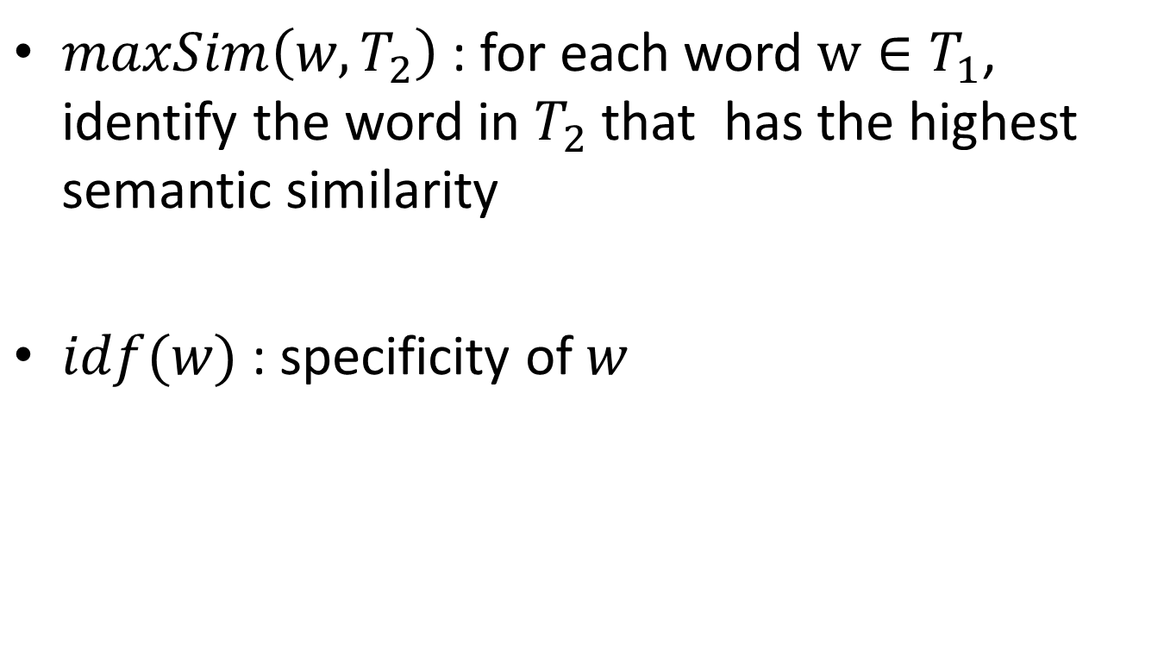
Notes
$maxSim\left(w, T_{2}\right)$ : for each word $w∈T_{1}$, identify the word in $T_{2}$ that has the highest semantic similarity
$idf(w)$ : specificity of $w$

Slide 118
Binary vs. Counting models [Lee ‘05]
This paper compares various computation models with human minds in short text similarity (correlation)
Argues that similarity is ultimately a psychological problem
Best computation model should model human performance well

Slide 119
Evaluation
Dataset
50 short news doc (51-126 words)
126 similar docs as backgrounding corpus
Human judgement
Inter-rater correlation: 0.605
Binary Models
x_{ik} = # of times i^{th} word (n-gram) occurs in k^{th} document
t_{ik} = 1 if x_{ik} > 0 and t_{ik} = 0 if x_{ik} = 0
Four different counts based on t_{ik}:
a_{ij}: number of words occurred in both doc i and j
b_{ij} and c_{ij}: number of words occurred in one but not the other doc
d_{ij}: number of words occurred in neither doc

Slide 120
Binary Similarity Models
Based on the previously defined a, b, c and d:
Common:
Ratio:
Distinct:
Ratio and Common better than distinct, and approaches best correlation (similarity) of 0.5 at 7-gram/8-gram
Common appears to have better precision at high similarity, but low recall

Slide 121
Count-Based Similarity Models
Four symmetric models [Rorvig ‘99]:
Correlation (Dice)
Jaccard
Cosine
Overlap
Performs about the same: approaches max similar at 4-gram and above
But in general not as good as the binary models!

Slide 122
LSA Similarity Model
Local weighting functions and global weighting functions
Weighted corpus representation W = [w_{ik}]
W is subjected to singular value decomposition:
choose a dimensionality d <= m for the subspace representation
find the n x d orthonormal matrix U, the d x d diagonal matrix D and the m x d orthonormal matrix V that minimize the squared difference $|\left|W−UDV^{T}\right||$
Varying the global weighting function is more significant
Overall LSA achieves 0.6 correlation, close to humans.

Slide 123
STASIS [O’Shea ’08]
A hybrid method
s(w1, w2) based on path length and depth of the two words in a lexical database (something like WordNet)
S(T1, T2) combines word position info and word frequency info from a large corpus
Correlation with mean human ratings:
STASIS: 0.816
LSA: 0.838
Average Human: 0.825
Worse Human: 0.594
Best Human: 0.921

Slide 124
Corpus-based + String similarity [Islam ‘08]
Proposed a method which combines:
String similarity
Corpus-based word semantic similarity
(optionally) common word order similarity

Slide 125
String Similarity
Longest Common Subsequence (LCS)
Take the weighted sum of three modified/normalized LCS
v₁ = len(LCS(s1, s2))²/(len(s1) x len(s2))
v₂ = len(MCLCS₁(s1, s2))²/(len(s1) x len(s2))
v₃ = len(MCLCS_{n}(s1, s2))²/(len(s1) x len(s2))
MCLCS₁ starts matching from 1st char
MCLCS_{n} starts matching from any char

Slide 126
Semantic Similarity between Words
Second Order Co-occurrence PMI (SOC-PMI)
Measure the similarity of two words by the PMI of their neighboring words in large corpus
The neighboring words are like bridges
m is the number of tokens in corpus
X_{i} is the set of neighboring words

Slide 127
Common Word Order Similarity
For two texts P and R: put the d common words into two lists, X and Y, preserving their order in the texts.
Common word order sim is:
x_{i} and y_{i} are index number (position) in the X

Slide 128
Overall Precedure
Step 1. Clean texts P and R
Step 2. remove d common words and what remains is P = {p₁, p₂, …, p_{m-d}}, and R = {r₁, r₂, …, r_{n-d}}
Step 3. construct (m-d) x (n-d) string similarity matrix M₁ between every pair of words
Step 4. construct (m-d) x (n-d) semantic similarity matrix M₂ between every pair of words
Step 5. construct joint matrix M = aM₁ + bM₂
a+b = 1 (weighting factors)
Find the max value r_{ij} from M, add it in a list L and remove all elements of i^{th} row and j^{th} column
Repeat this until r_{ij} = 0, or m-d- |L|=0
Step 6. Final score

Slide 129
Evaluation
Compared with Human Similarity
Human: 0.594-0.921 (mean at 0.825)
Li: 0.816
This work: 0.853
Microsoft Paraphrases
This is more difficult: P and R could be very similar but exact opposite with R having a “not”
At sim threshold of 0.6, precision = 0.75, recall = 0.9

Slide 130
Web-based Similarity Kernel (Sahami & Heilman 2006)
Similarity is inner-product of the expanded vector representation: $Sim (q,s) = QE(q) · QE(s)$
$D_{n}(x)$: the top $n$ documents returned by search engine for $x$
For each $d_{i}∈D_{n}\left(x\right)$, construct vector $v_{i}$, where each element is the weighted score $w_{ij}$ of term $t_{j}$
$$w_{ij}=tf_{ij}×\log{\frac{N}{df_{j}}}$$
$$C\left(x\right)=\frac{1}{n}\sum_{i=1}^{n}{\frac{v_{i}}{|\left|v_{i}\right||}}$$
$$QE\left(x\right)=C(x)/|\left|C\left(x\right)\right||$$
document frequency of $t_{j}$
term frequency of $t_{j}$ in $d_{i}$

Slide 131
Potential Issues
Using TF×IDF or its variations for the importance of a word in a given document
A word that appears in the beginning of a document is typically more important and relevant to the topic of the document
Words that appear in the document title should not be treated the same as words in the body.
Document frequency is effective in down-weighting stop words (with both high TF and DF scores)
Not all high DF words are useless
“travel”, “books”, “jobs”, “casino”,
UPS, AOL, Monster, CNN

Slide 132
Web-relevance Similarity Measure (Yih & Meek 2007)
A keyword extraction approach to term weighting,
Finding advertising keywords on web pages. WWW ’06, Yih, Goodman, & Carvalho
Phrases up to length 5
Procedure:
Construct a doc $d$ by concatenating the title / short summary of each document $d_{i}∈D_{n}\left(x\right)$
Construct a term vector $v$, where each element is the relevancy score $w_{j}$ determined by the keyword extraction approach
$QE\left(x\right)=\frac{v}{\left|\left|v\right|\right|}$
$Sim\left(q,s\right)= QE\left(q\right)×QE\left(s\right)$

Slide 133
Learning Similarity Measures: Method #1
Given $q$ and $s$, the goal is to learn a monotonic function $f$.
$f\left(q_{i},s_{i}\right)>f\left(q_{j},s_{j}\right)$ indicates that $q_{i},s_{i}$ are more alike than $q_{j},s_{j}$.
Training data:
When numeric similarities are given, a regression function can be learned
When only binary labels are given, a probability estimator can be learned

Slide 134
Learning Similarity Measures: Method #2
Learning to predict the pairwise preference of each pair of suggested candidates and , with respect to the same query .
Related work:
Burges et al 2005, Learning to rank using gradient descent. ICML.
[Xu 2011] Learning Similarity Function for Rare Queries.

Slide 135
User Behavior Based

Slide 136
User Behavior
Data source: Search results, user clicks, search sessions
Intuition: two queries should be similar to each other if they share similar behavior patterns, e.g. many co-clicked URLs or co-occurred sessions.
Potential problem: work well on common queries, but would fail on rare queries as there is insuﬃcient user behavior data for rare queries.

Slide 137
User Behavior
Jones et al, “Generating Query Substitutions”, WWW 2006
Rank suggestions using a linear regression model trained with 3 major types of features:
Surface characteristics: # of chars, # of words, …
Syntactic difference: edit distance, size of prefix overlapping, …
Substitution statistics: log-likelihood ratio or the mutual information between q and s using their distributions in the query logs

Slide 138
N-gram + Search Log
Learning Similarity Function for Rare Queries, WSDM 2011
Goal:
Learn the matrix M
Training data: click through data
Represent queries in n-gram space
Learning the similarity function
Locality sensitivity hashing for efficient retrieval of similar queries

Slide 139
N-gram representation
But, (New York times, NY times) and (New York times, movie times) will have the same score if we use cosine similarity directly.

Slide 140
Transformation between n-gram spaces
We try to ﬁnd a transformation that can make the angle between “NY” and “New York” approach to zero.

Slide 141
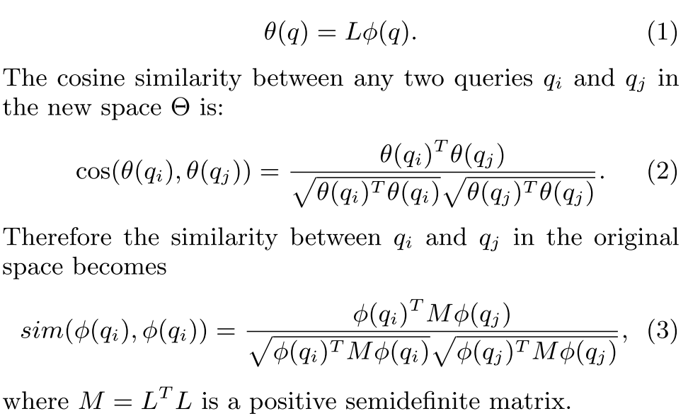
L: transformation

Slide 142
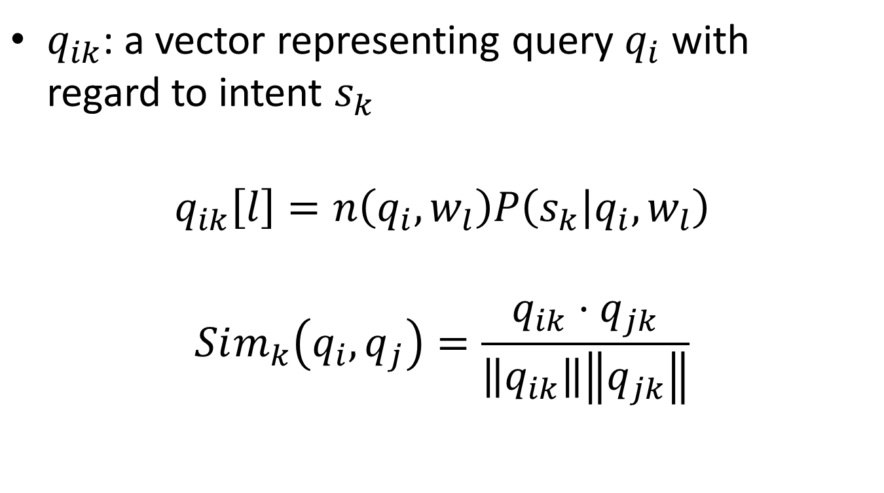
Query representation
$q_{ik}$: a vector representing query $q_{i}$ with regard to intent $s_{k}$
$$q_{ik}\left[l\right]=n\left(q_{i},w_{l}\right)P\left(s_{k} | q_{i},w_{l}\right)$$
$$Sim_{k}\left(q_{i},q_{j}\right)=\frac{q_{ik}⋅q_{jk}}{\left\|q_{ik}\right\|\left\|q_{jk}\right\|}$$

Slide 143
User Behavior (Other Works)
Q. Mei, D. Zhou, and K. Church. Query suggestion using hitting time. CIKM ’08
H. Ma, H. Yang, I. King, and M. R. Lyu. Learning latent semantic relations from clickthrough data for query suggestion. CIKM ’08
D. Beeferman and A. Berger. Agglomerative clustering of a search engine query log. KDD ’00
J.-R. Wen, J.-Y. Nie, and H.-J. Zhang. Clustering user queries of a search engine. WWW ’01
Z. Zhang and O. Nasraoui. Mining search engine query logs for query recommendation. WWW ’06

Slide 144
Intent aware query similarity
Intent Aware Query Similarity, CIKM 2011 (best paper award)
Augment the data:
Search result snippets, click-through data
Identifying the search intents
Topic model
Intent-aware representations
Measure query similarity under different search intents

Slide 145
A regularized topic model
Queries: $Q=\left\{q_{1},…,q_{n}\right\}$
Intents: $S=\left\{s_{1},…,S_{k}\right\}$
Each $q_{i}$ is represented by a set of words from query snippets: $W=\{w_{1},…,w_{m}\}$
Maximize:
$$L−λR$$
Where $λ$ is the regularization parameter, L is the likelihood, and
$$R=\sum_{i,j,k}{C_{ij}(P\left(s_{k} | q_{i}\right)−P\left(s_{k} | q_{j}\right))}$$

Slide 146
Summary from [Guo et al CIKM 11]
The similarity between queries is deﬁned on a query graph, or query relation graph [1, 2]. Therefore, the similarity is not pair-wise independent and the similarity of adjacent queries is considered. In some sense, graph-based measures can be considered as propagating the similarity on top of the query graph. For example, Craswell et al. [1] applied two types of random walk process to propagate the query similarity along the query-URL bipartite graph and obtain better similarity scores between queries. Mei et al. [3] described a random walk on the one-mode query graph and employed the hitting time as the similarity measure. In [4], Antonellis et al. used the bipartite SimRank on the query-URL graph to measure query similarity. In [5], matrix factorization was employed to calculate query similarity based on the user-query-URL tripartite graph. Recently, Bordino et al. [2] introduced the query-ﬂow graph based on the session data and employed graph projection to measure query similarity. Work on such a graph to compute query similarity can also be found in [6, 7]. However, if the queries are ambiguous, the graph based measures without the awareness of search intents will wrongly connect the queries with diﬀerent search intents.

Slide 147
Knowledge Based

Slide 148
Semantic Similarity in a Taxonomy
Philip Resnik, 1999

Slide 149
Semantic similarity in a taxonomy
A time-honored way: edge counting
Measure the distance between the nodes corresponding to the items being compared.
The shorter, the more similar.
If there are >1 paths, take the shortest one
Problem: Varying link distance
Links in the taxonomy represent uniform distance?
Narrow distance: (Rabbit Ears is-A Television Antenna), (Safety Valve is-A Valve)
Wide distance: (Phytoplankton is-A Living Thing), (Knitting Machine is-A Machine)

Slide 150
Philip Resnik, 1999
Measure similarity by information content
Combining a taxonomic structure with empirical probability estimates
Goal: disambiguation in NL:
(food handling and storage) procedures (food handling) and (storage procedures)

Slide 151
One key to the similarity of two concepts is the extent to which they share information
Edge counting measures “shared information” indirectly.

Slide 152
$p(c),$for any $c∈C$, is the probability of encountering an instance of concept of $c$
$p\left(c\right)$ is monotonically non-decreasing as one moves up the taxonomy:
if $c_{1}$ isA $c_{2}$, then $p\left(c_{1}\right)≤p(c_{2})$
If the taxonomy has a unique top node $r$ then $p(r)=1$

Slide 153
The information content of a concept is:
where is the set of concepts that subsume both
The concept that is structurally the minimal upper bound will be most informative.

Slide 154
Information content of a fragment of the WordNet taxonomy

Slide 155
For a word $w$, we use $S(w)$to denote the set of concepts in the taxonomy that are senses of word $w$
$wsim\left(w_{1},w_{2}\right)=\max_{c_{1}∈S\left(w_{1}\right),c_{2}∈S\left(w_{2}\right)}{[sim\left(c_{1},c_{2}\right)]}$

Slide 156
Improving Short-Text Classification Using Unlabeled Background Knowledge to Assess Document Similarity ICML 2000
Main idea: use a larger, unlabeled texts as background knowledge to bridge smaller training set and test text
Significantly decreases error rate

Slide 157
Approach
Use WHIRL, a conventional DB system augmented with text comparison abilities, e.g.
SELECT Test.instance, Train.label
FROM Train AND Test
WHERE Train.instance SIM Test.instance
WHIRL with background knowledge
SELECT Test.instance, Train.label
FROM Train AND Test AND Background
WHERE Train.instance SIM Background.value
AND Test.instance SIM Background.value

Slide 158
Evaluation
Data sets:
Tech papers
News
Web page titles
Company names
Compared WHIRL-nn (baseline) with RIPPER
Do better in tech papers and news but not so good in web page titles and company names
Compare WHIRL-bg with WHIRL-nn
WHIRL-bg is less sensitive to training data size, in other words, it requires little training data to achieve rather good performance

Slide 159
Evaluation

Slide 160
Metric
Area Under the Curve (AUC) score [Yih 2007]:
Precision at k
Top ranked k elements
Coverage (Recall)
Surface matching
Corpus-based
Learning-based

Slide 161
Human Judgements
[Lee et al., 2005] compares various computation models with human minds in short text similarity (correlation)
Human judgement
Judge rate with 4-point scale: excellent, good, fair and bad
Convert to binary decision: relevant or irrelevant
Inter-rater correlation: 0.605

Slide 162
Test Data
Microsoft para- phrase corpus (Dolan, Quirk, & Brockett 2004), consisting of 4,076 training and 1,725 test pairs

